Slide 1
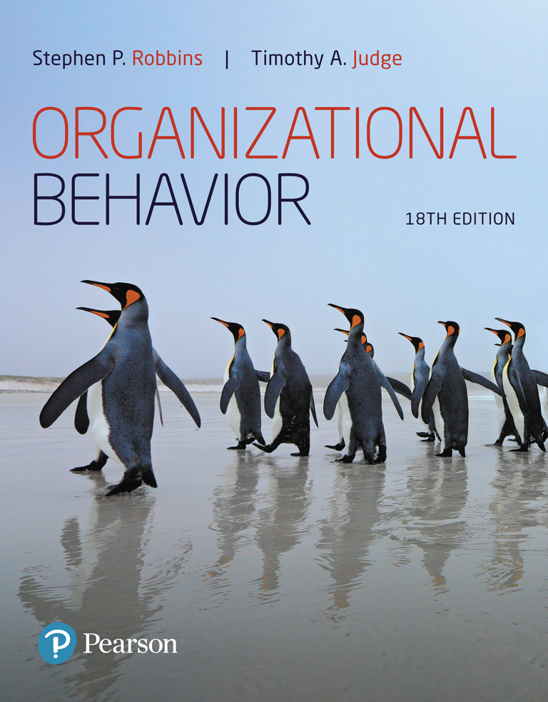
Organizational Behavior
Eighteenth Edition
Lecture 1
What Is Organizational Behavior?
Copyright © 2019, 2017, 2015, 2013 Pearson Education, Inc. All Rights Reserved.
Notes:
If this PowerPoint presentation contains mathematical equations, you may need to check that your computer has the following installed:
1) MathType Plugin
2) Math Player (free versions available)
3) NVDA Reader (free versions available)
Welcome to this Organizational Behavior course that uses the 18th edition of the textbook, Organizational Behavior by Robbins and Judge. This is considered among the most widely used OB textbooks in the world. Robbins and Judge are recognized as definitive aggregators of OB concepts, applications, and practices. The course and this book will provide you with a resource that will benefit you throughout your degree program and your professional life.

Slide 2
Learning Objectives
1.1 Demonstrate the importance of interpersonal skills in the workplace.
1.2 Define organizational behavior (OB).
1.3 Show the value to OB of systematic study.
1.4 Identify the major behavioral science disciplines that contribute to OB.
1.5 Demonstrate why few absolutes apply to OB.
1.6 Identify managers’ challenges and opportunities in applying OB concepts.
1.7 Compare the three levels of analysis in this text’s OB model.
1.8 Describe the key employability skills gained from studying OB applicable to other majors or future careers.
Notes:
The first chapter entitled “What is Organizational Behavior,” begins by defining eight learning objectives for the chapter. These lay a foundational understanding for the origins of OB and its applications in management and organizational existence. You should focus on this chapter to ground yourself, and as a starting place for the more complex and significant concepts throughout the book. We will elaborate on each of these objectives to ensure that you acquire a base knowledge of the core OB competencies.

Slide 3
Demonstrate the Importance of Interpersonal Skills in the Workplace
Interpersonal skills are important because…
‘Good places to work’ have better financial performance.
Better interpersonal skills result in lower turnover of quality employees and higher quality applications for recruitment.
There is a strong association between the quality of workplace relationships and job satisfaction, stress, and turnover.
It fosters social responsibility awareness.
Notes:
Managers need a cadre of skills to create a productive workplace, including technical and quantitative skills. However, leadership and communication skills are critical to organizational success. When managers have solid interpersonal skills, there are positive work outcomes for the organization. These outcomes include lower turnover of strong employees, improved recruitment pools for filling employment positions, and a better bottom line.

Slide 4
Describe the Manager’s Functions, Roles, and Skills (1 of 4)
    Manager: Someone who gets things done through other people in organizations.
    Organization: A consciously coordinated social unit composed of two or more people that functions on a relatively continuous basis to achieve a common goal or set of goals.
        Planning, organizing, leading, and controlling.
    Mintzberg concluded that managers perform ten different, highly interrelated roles or sets of behaviors attributable to their jobs.
Notes:
A manager is someone in the organization who gets things done through the efforts of other people. It is important to keep in mind that an organization is defined as a social entity comprised of two or more people and can be found at any level within the organization.
The work of managers revolves around four functions: planning, organizing, leading, and controlling. When thinking about these functions, one realization comes forward: that they all involve the interpersonal skills of communication for their effective implementation.
Henry Mintzberg looked at management differently when he defined the 10 roles of managers. As shown on the next slide, you will see that they again involve implementation through the interpersonal skills of communication.

Slide 5
Describe the Manager’s Functions, Roles, and Skills (2 of 4)
Exhibit 1-1 Minztberg’s Managerial Roles
Role | Description
Interpersonal | Blank
Figurehead | Symbolic head; required to perform a number of routine duties of a legal or social nature
Leader | Responsible for the motivation and direction of employees
Liaison | Maintains a network of outside contacts who provide favors and information
Informational | Blank
Monitor | Receives a wide variety of information; serves as nerve center of internal and external information of the organization
Disseminator | Transmits information received from outsiders or from other employees to members of the organization
Notes:
In fact, if you look at the three categories of roles suggested by Mintzberg – interpersonal, informational, and decisional—you will note the distribution of communication and interpersonal skills such as tact, diplomacy, and the like, focusing on both internal and external audiences in the role’s activities. For this reason, developing the interpersonal skills introduced in this course is essential to the professional development of young professionals and is essential to managerial success.

Slide 6
Describe the Manager’s Functions, Roles, and Skills (3 of 4)
[Exhibit 1-1 Continued]
Role | Description
Spokesperson | Transmits information to outsiders on organization’s plans, policies, actions, and results; serves as expert on organization’s industry
Decisional | Searches organization and its environment for opportunities and initiates projects to bring about change
Entrepreneur | Responsible for corrective action when organization faces important, unexpected disturbances
Resource allocator | Makes or approves significant organizational decisions
Negotiator | Responsible for representing the organization at major negotiations
Source: H. Mintzberg, The Nature of Managerial Work, 1st ed., © 1973, pp. 92–93. Reprinted and electronically reproduced by permission of Pearson Education, Inc., New York, NY.
Notes:
In fact, if you look at the three categories of roles suggested by Mintzberg—interpersonal, informational, and decisional—you will note the distribution of communication and interpersonal skills such as tact, diplomacy, and the like, focusing on both internal and external audiences in the role’s activities. For this reason, developing the interpersonal skills introduced in this course is essential to the professional development of young professionals and is essential to managerial success.

Slide 7
Describe the Manager’s Functions, Roles, and Skills (4 of 4)
  Management Skills
    Technical Skills – the ability to apply specialized knowledge or expertise. All jobs require some specialized expertise, and many people develop their technical skills on the job.
    Human Skills – the ability to work with, understand, and motivate other people.
    Conceptual Skills – the mental ability to analyze and diagnose complex situations.
Notes:
What skills do managers need to effectively achieve their goals? Researchers have identified several skills that set successful managers apart from their less effective counterparts. These include technical skills, human skills, and conceptual skills.

Slide 8
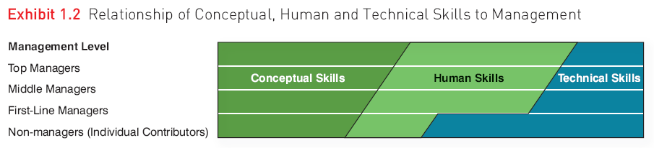
Relationship of Skills to Management (from Daft et al.)
0

Slide 9
Effective Versus Successful Managerial Activities (1 of 2)
Luthans and his associates found that all managers engage in four managerial activities:
  Traditional management
  Communication
  Human resource management
  Networking
Notes:
Luthans and his research associates found that all managers engage in four managerial activities.
Traditional management is decision making, planning, and controlling. The average manager spent 32 percent of his or her time performing this activity.
Communication involves exchanging routine information and processing paperwork. The average manager spent 29 percent of his or her time performing this activity.
Human resource management includes motivating, disciplining, managing conflict, staffing, and training. The average manager spent 20 percent of his or her time performing this activity.
Networking is socializing, politicking, and interacting with outsiders. The average manager spent 19 percent of his or her time performing this activity.

Slide 10
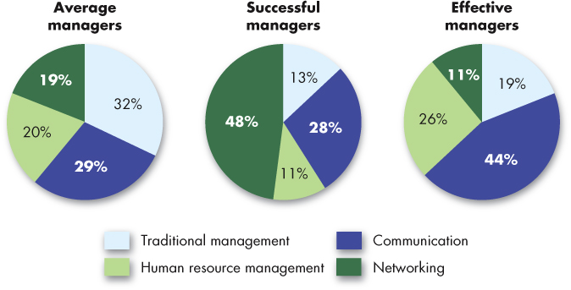
Effective Versus Successful Managerial Activities (2 of 2)
Exhibit 1-2 Allocation of Activities by Time
Source: Based on F. Luthans, R. M. Hodgetts, and S. A. Rosenkrantz, Real Managers (Cambridge, MA: Ballinger, 1988).
Notes:
Managers who were high performing in these activities were found to be fast-tracked through organizational promotion.

Slide 11
Define Organizational Behavior
Organizational behavior (OB) is a field of study that investigates the impact that individuals, groups, and structure have on behavior within organizations for the purpose of applying such knowledge toward improving an organization’s effectiveness.
Notes:
Organizational behavior (OB) is a field of study that investigates the impact that individuals, groups, and structure have on behavior within organizations for the purpose of applying such knowledge toward improving an organization’s effectiveness. More specifically, OB explores motivation, leader behavior and power, interpersonal communication, group structure and processes, attitude development and perception, change processes, conflict and negotiation, and work design.

Slide 12
Complementing Intuition with Systematic Study
Systematic Study of Behavior
  Behavior generally is predictable if we know how the person perceived the situation and what is important to him or her.
Evidence-Based Management (EBM)
  Complements systematic study.
  Argues for managers to make decisions based on evidence.
Intuition
  Systematic study and EBM add to intuition, or those “gut feelings” about “why I do what I do” and “what makes others tick.”
  If we make all decisions with intuition or gut instinct, we’re likely working with incomplete information.
Notes:
Many people say that the ideas and concepts of OB are common sense. However, the systematic study of OB has come closer to finding ways to predict the behavior of individuals and groups through an understanding of the situation and composition of the people. Evidence-based management (EBM) complements systematic study by basing managerial decisions on the best available scientific evidence.
“Intuition” is a decision-making approach advocated by numerous managers and pundits. However, if we make all decisions with intuition or gut instinct, we likely working with incomplete information. EBM and the systematic study of behavior enhance the understanding of these internal contributors to organizational behavior.

Slide 13
Big Data
  Background:
    The use of Big Data for managerial practices is a relatively new area, but one that holds convincing promise.
  Current Usage:
  The reasons for data analytics include predicting any event, detecting how much risk is incurred at any time, and preventing catastrophes.
  New Trends:
  The use of Big Data for understanding, helping, and managing people is relatively new but holds promise.
  Limitations:
  Use evidence as much as possible to inform your intuition and experience.
Notes:
The recent availability of “big data” shows promise for the field of OB, potentially providing evidence that can be used to support intuition and experience.

Slide 14
Identify the Major Behavioral Science Disciplines That Contribute to OB (1 of 4)
Organizational behavior is an applied behavioral science that is built upon contributions from a number of behavioral disciplines:
  Psychology
  Social psychology
  Sociology
  Anthropology
Notes:
OB is a behavioral social science that merges concepts from a number of different social sciences to apply specifically to the organizational setting at both the individual (or micro) and group (or macro) levels. The most significant social sciences are psychology, social psychology, sociology, and anthropology. Look at each for a moment.

Slide 15
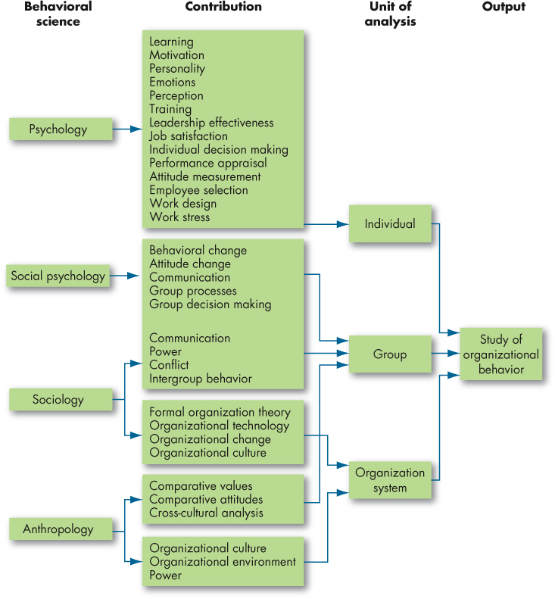
Identify the Major Behavioral Science Disciplines That Contribute to OB (2 of 4)
Exhibit 1-3 Toward an OB Discipline
Notes:
This exhibit shows the contributions made by other disciplines to the development of organizational behavior. Notice the predominant areas of psychology, social psychology, sociology, and anthropology. Each of the disciplines has contributed specific concepts and theories to the study of OB and its increasing applications.

Slide 16
Identify the Major Behavioral Science Disciplines That Contribute to OB (3 of 4)
  Psychology
  seeks to measure, explain, and sometimes change the behavior of humans and other animals.
  Social psychology
  blends the concepts of psychology and sociology.
Notes:
Psychology focuses on the individual level by seeking to measure, explain, and sometimes change behaviors in individuals. This area of study offers insights into such areas as learning, training, decision-making, and employee selection.
Social psychology moves beyond individual analysis to look at group behavior and how individuals can influence one another. It blends together sociology and psychology and looks primarily at change, communication, and group interactions.

Slide 17
Identify the Major Behavioral Science Disciplines That Contribute to OB (4 of 4)
  Sociology
  studies people in relation to their social environment or culture.
  Anthropology
  is the study of societies to learn about human beings and their activities.
Notes:
Sociology looks at the relationship between people and their environment. Sociologists’ main contribution to OB has been a better understanding of group behavior, particularly in formal and complex organizations. Another key area that sociologists contribute to in OB is organizational culture, a key factor in OB studies.
Anthropologists study societies to learn about human beings and their activities. They help us understand the differences between different groups in terms of their values, attitudes, and behaviors.

Slide 18
Demonstrate Why Few Absolutes Apply to OB
There are few, if any, simple and universal principles that explain organizational behavior.
  Contingency variables situational factors are variables that moderate the relationship between the independent and dependent variables.
Notes:
There are few absolutes in organizational behavior. When making decisions, you must always take into account the situational factors that can change the relationship between two variables. Every situation has the potential to have unseen factors or even known factors that can change rapidly. Opening your minds to detecting these changes and unseen factors, and to being ready with optional responses, is essential to effective management.

Slide 19
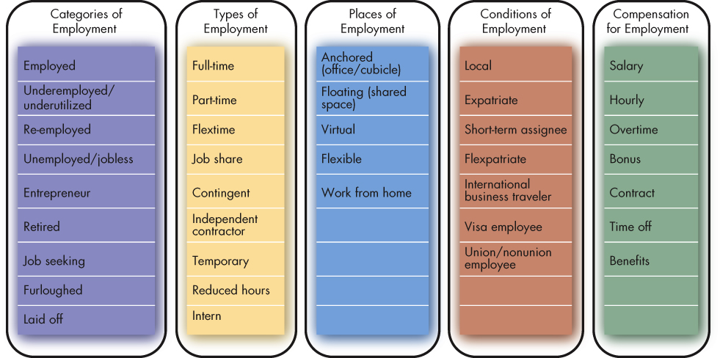
Identify the Challenges and Opportunities of OB Concepts (1 of 12)
Exhibit 1-4 Employment Options
Sources: Based on J. R. Anderson, E. Binney, N. M. Davis, G. Kraft, S. Miller, T. Minton-Eversole, . . . and A. Wright, “Action Items: 42 Trends Affecting Benefits, Compensation, Training, Staffing and Technology,” HR Magazine (January 2013): 33; M. Dewhurst, B. Hancock, and D. Ellsworth, “Redesigning Knowledge Work,” Harvard Business Review (January–February 2013): 58–64; E. Frauenheim, “Creating a New Contingent Culture,” Workforce Management (August 2012): 34–39; N. Koeppen, “State Job Aid Takes Pressure off Germany,” The Wall Street Journal, February 1, 2013, A8; and M. A. Shaffer, M. L. Kraimer, Y.-P. Chen, and M. C. Bolino, “Choices, Challenges, and Career Consequences of Global Work Experiences: A Review and Future Agenda,” Journal of Management (July 2012): 1282–1327.
Notes:
Today’s economic uncertainty has created new challenges in the workplace. This exhibit shows some of the types of options individuals may have or would like to have.

Slide 20
Identify the Challenges and Opportunities of OB Concepts (2 of 12)
Responding to economic pressure
  In tough economic times, effective management is an asset.
  In good times, understanding how to reward, satisfy, and retain employees is at a premium.
  In bad times, issues like stress, decision making, and coping come to the forefront.
Notes:
During economic difficulties, the need for effective management is heightened. Anyone can manage during good times; it is much tougher to manage effectively through economic struggles.
In bad economic times, resource constraints may force managers to make tough decisions, such as whether to lay off employees. It can also be difficult to motivate employees when resources are limited. Moreover, managers must be able to deal with employees who are stressed about their futures.

Slide 21
Identify the Challenges and Opportunities of OB Concepts (3 of 12)
Responding to globalization
  Increased foreign assignments.
  Working with people from different cultures.
  Overseeing movement of jobs to countries with low-cost labor.
  Adapting to differing cultural and regulatory norms.
Notes:
Globalization means that organizations now exist in an environment with no national borders. As a result, the manager’s job has changed. Managers today need to have a broader perspective when making decisions.
As foreign assignments increase, you will need to be able to manage a workforce that is different than what you may be used to, and which may bring different needs, aspirations, and attitudes to the workplace.
You will also have individuals who come from different cultures coming to work in your own country. You will need to find ways to accommodate their needs and help them assimilate to your workplace culture.
As more jobs move to countries with low-cost labor, managers will need to balance the needs of their organizations with the needs of the countries in which they operate.
In the new global village, managers need to understand the implications of differing cultural and legal practices on their operations. Violating local regulations and practices could have serious consequences for the organization.

Slide 22
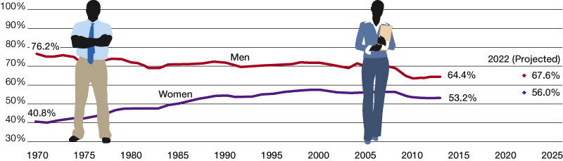
Identify the Challenges and Opportunities of OB Concepts (4 of 12)
OB POLL Percentage of Men and Women Working
Sources: Based on U.S. Bureau of Labor Statistics, “Women in the Labor Force: A Datebook,” 2014, www.bls.gov/opub/reports/cps/women-in-the-labor-force-adatabook-2014.pdf; and U.S. Bureau of Labor Statistics, “Economic News Release,” 2013, http://www.bls.gov/news.release/ecopro.t02.htm.
Notes:
As students of OB, we can investigate what factors lead employees to make various choices and how their experiences affect their perceptions of their workplaces. In turn, this can help us predict organizational outcomes. As shown in the OB Poll for example, the days when women stayed home because it was expected are just a memory in some cultures, while in others, women still face significant barriers to entry into the workplace.

Slide 23
Identify the Challenges and Opportunities of OB Concepts (5 of 12)
Managing workforce diversity
  Workforce diversity – organizations are becoming more heterogeneous in terms of gender, age, race, ethnicity, sexual orientation, and inclusion of Workforce other diverse groups.
Notes:
As the borders are disappearing, we are seeing more and more heterogeneity in the workplace. Managers today need to embrace diversity and find ways to manage it effectively. The changing demographics have shifted management philosophy in a way that recognizes and utilizes differences to create productivity, profitability, and welcoming workplace cultures.

Slide 24
Identify the Challenges and Opportunities of OB Concepts (6 of 12)
Improving customer service
  Service employees have substantial interaction with customers.
  Employee attitudes and behavior are associated with customer satisfaction.
  Need a customer-responsive culture.
Notes:
Many jobs today involve substantial interaction with customers. Managers can increase the chance that these interactions will be successful by focusing on employee attitudes and behavior. Companies need to develop customer-responsive cultures wherein employees are friendly and courteous, accessible, knowledgeable, prompt with their responses, and willing to do what is necessary to ensure that customers are satisfied.

Slide 25
Identify the Challenges and Opportunities of OB Concepts (7 of 12)
Improving people skills
  People skills are essential to managerial effectiveness.
  OB provides the concepts and theories that allow managers to predict employee behavior in given situations.
Notes:
Because organizations are composed of people, organizations cannot achieve desired outcomes without them. Therefore, the skills to manage people successfully are essential to the effectiveness of anyone in a managerial or leadership role. OB provides the concepts and theories that help predict behavior to create a more effective organization, accomplishing desired goals.

Slide 26
Identify the Challenges and Opportunities of OB Concepts (8 of 12)
Working in networked organizations
  Networked organizations are becoming more pronounced.
  A manager’s job is fundamentally different in networked organizations.
  Challenges of motivating and leading “online” require different techniques.
Notes:
Networked organizations are proliferating. These are organizations that are spread over geographic, time, or other boundaries and that are connected by technology. Managing and leading people who never see each other but who work together requires a different set of management and leadership skills.

Slide 27
Identify the Challenges and Opportunities of OB Concepts (9 of 12)
Using social media at work
  Policies on accessing social media at work.
    When, where, and for what purpose.
  Impact of social media on employee well-being.
Notes:
Social media is a difficult issue for today’s manager, presenting both a challenge and an opportunity for OB.

Slide 28
Identify the Challenges and Opportunities of OB Concepts (10 of 12)
Enhancing employee well-being at work
  The creation of the global workforce means work no longer sleeps.
  Communication technology has provided a vehicle for working at any time or any place.
  Employees are working longer hours per week.
  The lifestyles of families have changed—creating conflict.
  Balancing work and life demands now surpasses job security as an employee priority.
Notes:
Because of the expansion of networked business to global competition, time is no longer a definable boundary of organizational activity and personnel responsibility. Managers and leaders of organizations are challenged to help employees find ways to balance work and life roles to ensure they remain effective and viable members of the team. Employees who feel as though they don’t get a break and who believe they must work 24 hours a day can be less effective, suffering from burnout and dissatisfaction.

Slide 29
Identify the Challenges and Opportunities of OB Concepts (11 of 12)
Creating a positive work environment
  Positive organizational scholarship is concerned with how organizations develop human strength, foster vitality and resilience, and unlock potential.
  This field of study focuses on employees’ strengths versus their limitations, as employees share situations in which they performed at their personal best.
Notes:
Creating a positive work environment has been found to be a basis for employee satisfaction, increased productivity, and longevity of skilled personnel. Responsibility for positive work environments is not a part of traditional management practice, but as the work environment has changed in terms of characteristics and behaviors of younger generations, the focus on making work a good place to be has become more important for success. Positive organizational scholarship studies what is “good” about organizations.

Slide 30
Identify the Challenges and Opportunities of OB Concepts (12 of 12)
Improving ethical behavior
  Ethical dilemmas and ethical choices are situations in which an individual is required to define right and wrong conduct.
  Good ethical behavior is not so easily defined.
  Organizations distribute codes of ethics to guide employees through ethical dilemmas.
  Managers need to create an ethically healthy climate.
Notes:
Increased scrutiny by society and governmental entities has increased business concerns with ethical behavior. Lapses in ethical behavior have resulted in everything ranging from public sanctions against businesses to legal penalties against a firm and its managers.
Ethical dilemmas require managers to make decisions involving right and wrong conduct. Managers and leaders must clearly define what constitutes appropriate, ethical behavior by the organization and its people, and they must lead by example.

Slide 31
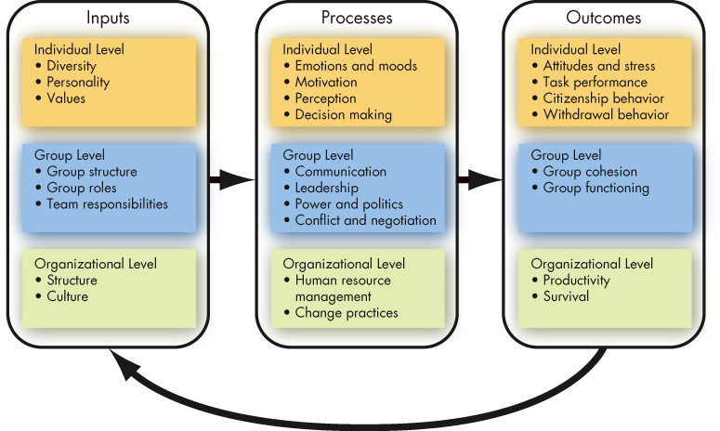
Three Levels of Analysis in This Text’s OB Model
Exhibit 1-5 A Basic OB Model
Notes:
This book proposes three types of variables—inputs, processes, and outcomes—at three levels of analysis: individual, group, and organizational.
The basic OB model here proceeds from left to right, with inputs leading to processes and processes leading to outcomes. Notice that the model also shows that outcomes can influence inputs in the future.

Slide 32
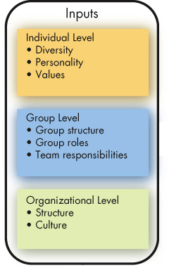
Three Levels of Analysis in This Book’s OB Model (1 of 3)
Inputs
  Variables like personality, group structure, and organizational culture that lead to processes.
  Group structure, roles, and team responsibilities are typically assigned immediately before or after a group is formed.
  Organizational structure and culture change over time.
Notes:
Inputs are factors that exist in advance of the employment relationships. For example, individual diversity characteristics, personality, and values are shaped by a combination of an individual’s genetic inheritance and childhood environment.
Group structure, roles, and team responsibilities are typically assigned immediately before or after a group is formed.
Finally, organizational structure and culture are usually the result of years of development and change as the organization adapts to its environment and builds up customs and norms.

Slide 33
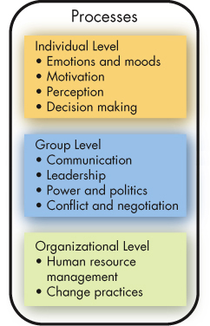
Three Levels of Analysis in This Book’s OB Model (2 of 3)
Processes
  If inputs are like the nouns in organizational behavior, processes are like verbs.
  Defined as actions that individuals, groups, and organizations engage in as a result of inputs, and that lead to certain outcomes.
Notes:
Processes are actions that individuals, groups, and organizations engage in as a result of inputs, and that lead to certain outcomes.
At the individual level, processes include emotions and moods, motivation, perception, and decision-making.
At the group level, they include communication, leadership, power and politics, and conflict and negotiation.
Finally, at the organizational level, processes include human resource management and change practices.

Slide 34
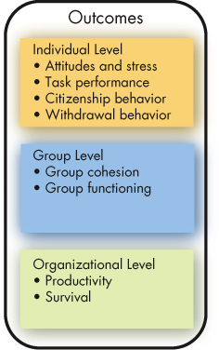
Three Levels of Analysis in This Book’s OB Model (3 of 3)
Outcomes
  Key variables that you want to explain or predict, and that are affected by some other variables.
Notes:
Scholars have emphasized individual-level outcomes like attitudes and satisfaction, task performance, citizenship behavior, and withdrawal behavior.
At the group level, cohesion and functioning are the dependent variables.
Finally, at the organizational level, we look at overall profitability and survival.
Because these outcomes will be covered in all of the chapters, we will briefly discuss each of them on the following slides, so you can understand what the “goal” of OB will be.

Slide 35
Outcome Variables (1 of 6)
Attitudes and stress
  Employee attitudes are the evaluations employees make, ranging from positive to negative, about objects, people, or events.
  Stress is an unpleasant psychological process that occurs in response to environmental pressures.
Notes:
The belief that satisfied employees are more productive than dissatisfied employees has been a basic tenet among managers for years, though only now research has begun to support it. Some people might think that influencing employee attitudes and stress is purely soft stuff, and not the business of serious managers, but as we will show, attitudes often have behavioral consequences that relate directly to organizational effectiveness.

Slide 36
Outcome Variables (2 of 6)
Task performance
  The combination of effectiveness and efficiency at doing your core job tasks is a reflection of your level of task performance.
Notes:
Task performance is the most important human output contributing to organizational effectiveness, so in every chapter we devote considerable time to discussing how task performance is affected by specific topics.

Slide 37
Outcome Variables (3 of 6)
Organizational citizenship behavior
  The discretionary behavior that is not part of an employee’s formal job requirements, and that contributes to the psychological and social environment of the workplace, is called organizational citizenship behavior.
Notes:
In today’s dynamic workplace, where tasks are increasingly performed by teams and flexibility is critical, employees who engage in good citizenship behaviors help others on their team by volunteering for extra work, avoiding unnecessary conflicts, respecting the spirit as well as the letter of rules and regulations, and gracefully tolerating occasional work-related impositions and nuisances.

Slide 38
Outcome Variables (4 of 6)
Withdrawal behavior
  Withdrawal behavior is the set of actions that employees take to separate themselves from the organization.
Notes:
Employee withdrawal can have a very negative effect on an organization. The cost of employee turnover alone has been estimated to run into the thousands of dollars, even for entry-level positions. Absenteeism also costs organizations significant amounts of money and time every year. For instance, a recent survey found the average direct cost to U.S. employers of unscheduled absences is 8.7 percent of payroll.

Slide 39
Outcome Variables (5 of 6)
Group cohesion
  Group cohesion is the extent to which members of a group support and validate one another at work.
Group functioning
  Group functioning refers to the quantity and quality of a group’s work output.
Notes:
When employees trust one another, seek common goals, and work together to achieve these common goals, the group is cohesive. Conversely, when employees are divided among themselves in terms of what they want to achieve and have little loyalty to one another, the group is not cohesive. And the greater the group’s cohesion, the greater the effect of group functioning that leads to effective outcomes and satisfying impacts on group members.

Slide 40
Outcome Variables (6 of 6)
Productivity
  An organization is productive if it achieves its goals by transforming inputs into outputs at the lowest cost. This requires both effectiveness and efficiency.
Survival
  The final outcome is organizational survival, which is simply evidence that the organization is able to exist and grow over the long term.
Notes:
Popular measures of organizational efficiency include return on investment, profit per dollar of sales, and output per hour of labor. Service organizations must include customer needs and requirements in assessing their effectiveness. These measures of productivity are affected by the behaviors of managers, employees, and supervisors. Increased productivity leads to the ultimate goal of most organizations, which is the survival of the firm.

Slide 41
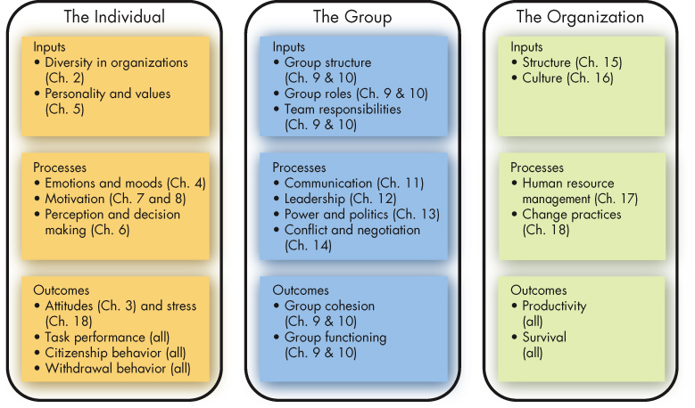
The Plan of the Text
Exhibit 1-6 The Plan of the Text
Notes:
As you can see in this exhibit, we will deal with inputs, processes, and outcomes at all three levels of analysis, but we group the chapters as shown here to correspond with the typical ways that research has been done in these areas.

Slide 42
Implications for Managers (1 of 2)
Resist the inclination to rely on generalizations; some provide valid insights into human behavior, but many are erroneous.
Use metrics and situational variables rather than “hunches” to explain cause-and-effect relationships.
Work on your interpersonal skills to increase your leadership potential.
Notes:
This first chapter has provided a firm foundation that will be the basis for the study and application of concepts and practices that make the young professional more successful in productivity, job satisfaction, and career development. The systematic study of OB can improve predictability of behavior and, while it is not perfect, it provides excellent roadmaps to guide managers and leaders. These studies help to ensure that contingencies are in place to better understand people’s behaviors and how to influence them for the success of the employee and the organization.

Slide 43
Implications for Managers (2 of 2)
Improve your technical skills and conceptual skills through training and staying current with OB trends like big data and fast data.
OB can improve your employees’ work quality and productivity by showing you how to empower your employees, design and implement change programs, improve customer service, and help your employees balance work-life conflicts.
Notes:
It is important for managers to develop their interpersonal “people skills” to be effective. Understanding OB makes their organizations work more effectively by improving productivity, reducing absenteeism, turnover, and deviant workplace behavior, and increasing organizational citizenship behavior and job satisfaction.

Slide 44
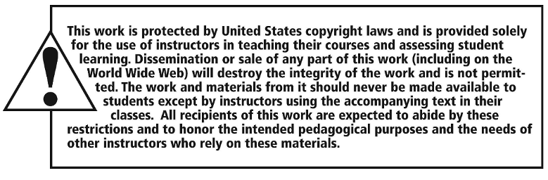
Copyright

